Slide 1
Whole Day, Whole Year, Whole Child
Designing a new reality for school day/expanded learning partnership
September 16, 2024
10:00am-4:00pm

Slide 2
Introductions
Please share your name, role and organization

Slide 3
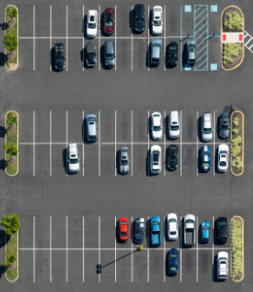
AGENDA
Welcome & Introduction
Setting Context
The Proposed Work
What We Know & Wonder
Finding Common Ground
Our Shared Vision
The Education Landscape
Barriers
Defining Innovative Strategies
Closing & Next Steps
Parking Lot
Lunch
Notes:
Team Health – 30 Minutes
Org overview – 30 minutes
Defining priorities 1 – 1 hour
Defining Priorities 2 – 1 Hour
OKRs are Homework a
Calibrating for Success – 30 Minutes

Slide 4
OBJECTIVE
Participants will develop and agree on three to five innovative strategies to increase coherence between school day and expanded learning practice in order to improve learning conditions for young people.
Notes:
Calibrating for Success – 30 Minutes

Slide 5
Key Question
What are the opportunities for coherence between expanded learning and school day practice that will improve learning conditions for young people?

Slide 6
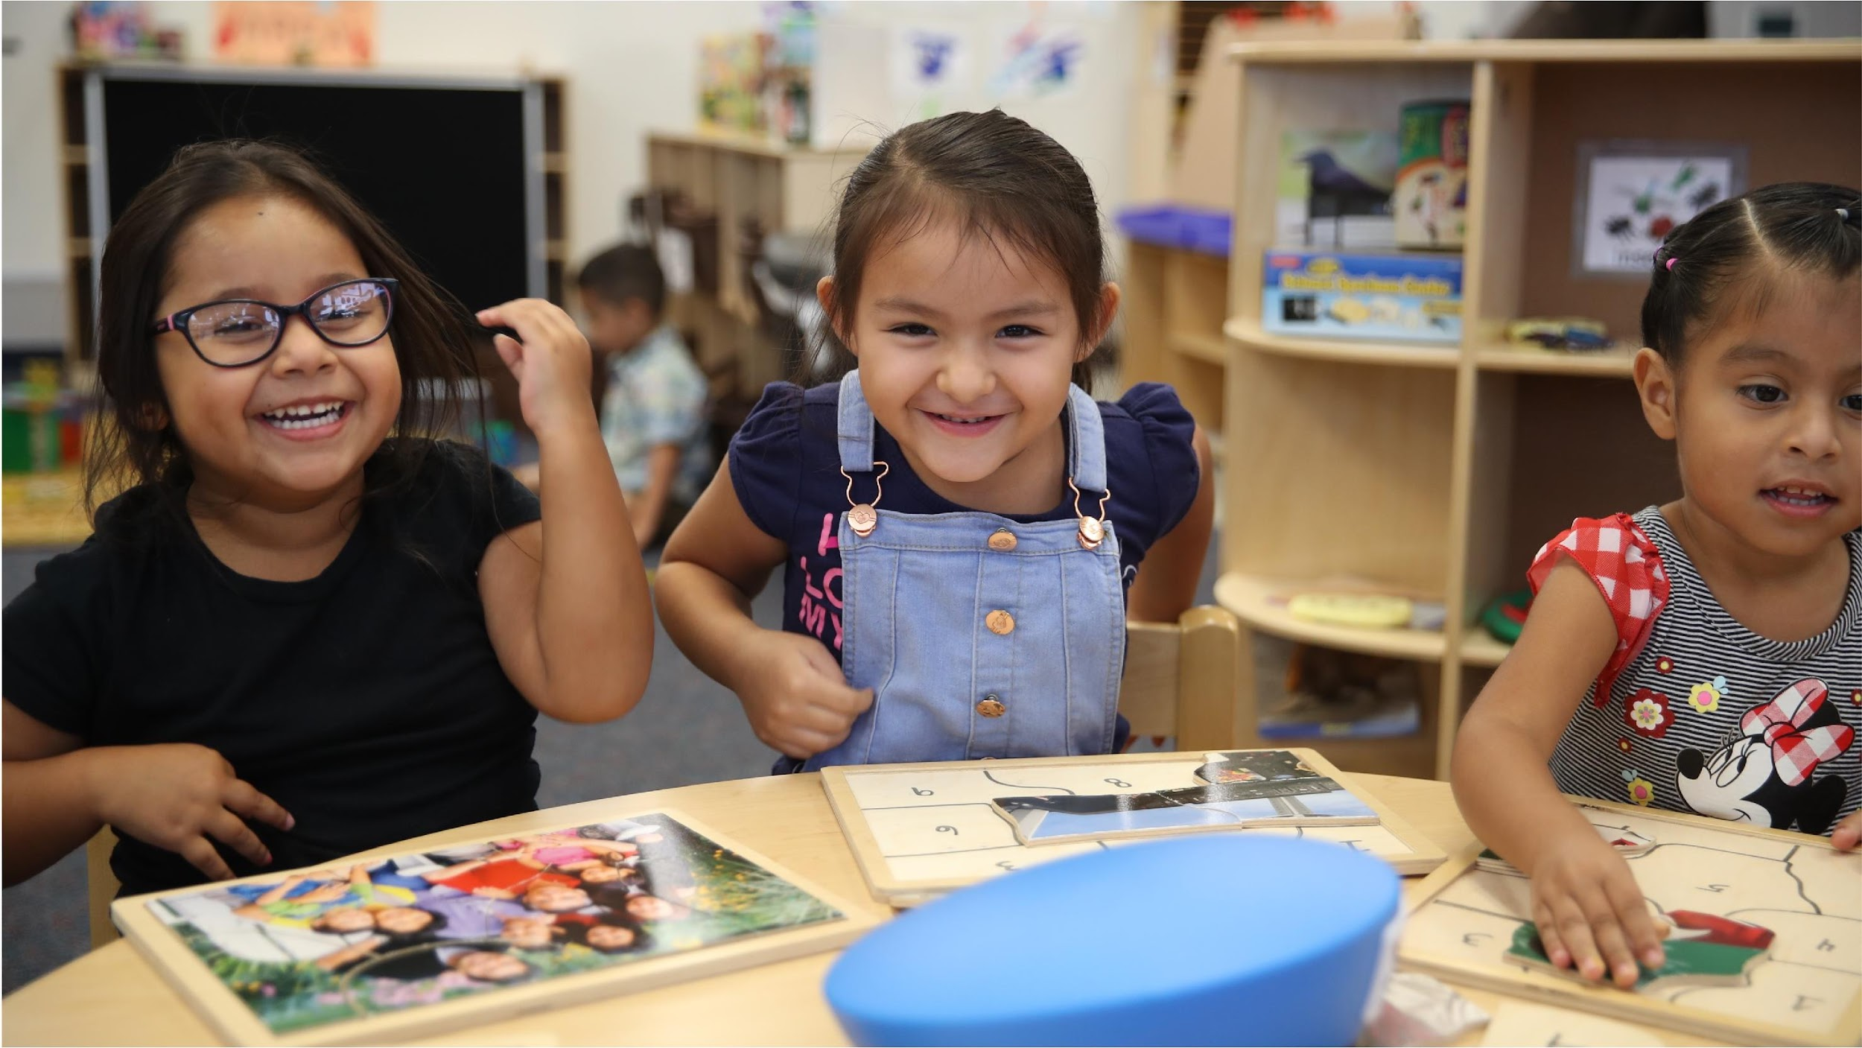
MINGLE
What did you love about school?
What did you do when you weren’t at school?
What elements of your out-of-school life would have made your school experience more enriching?

Slide 7
Context: The Proposed Work
Purpose: Understand the direction and scope of this work.
Notes:
Objective: aligning for

Slide 8
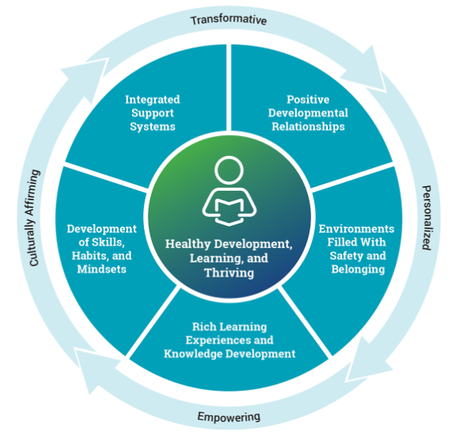
Guiding Principles for Equitable Whole Child Design
Learning Policy Institute & Turnaround for Children, 2021
PART OF A LARGER CONVERSATION:
Coherence around the Whole-Child Approach
Notes:
T2 - July 2014
Carrie - Sept 2023
Jaclyn - Oct 2023
Zoe - Dec 2022
SPT Dept launch in Fall 2018
expanding Randy's capacity
Government Relations and Advocacy work to support funding consistency
2018 - 3 People, newly resourced 2022
PDT, always existed, in new configuration Fall 2022
Program Design & Student Impact (articulating)
Content and Curriculum for every level of the program
Program Delivery systems and resources
"PDT team prior to 2022 existed of: Sr Dir; 3 Director; 4 PBSs & CCRSs"
The PDT Footprint has
There have been additional resources
Now:
3 Directors
Program Design Trainers
OY Manager
Currently working on Operations
Innovations Lab 2023
Collaborative Design Solutions (Internal and External Collaborators to build new programmatically and new solutions in a collaborative way)
Why do these departments all fall together?

Slide 9
Notes:
T2 - July 2014
Carrie - Sept 2023
Jaclyn - Oct 2023
Zoe - Dec 2022
SPT Dept launch in Fall 2018
expanding Randy's capacity
Government Relations and Advocacy work to support funding consistency
2018 - 3 People, newly resourced 2022
PDT, always existed, in new configuration Fall 2022
Program Design & Student Impact (articulating)
Content and Curriculum for every level of the program
Program Delivery systems and resources
"PDT team prior to 2022 existed of: Sr Dir; 3 Director; 4 PBSs & CCRSs"
The PDT Footprint has
There have been additional resources
Now:
3 Directors
Program Design Trainers
OY Manager
Currently working on Operations
Innovations Lab 2023
Collaborative Design Solutions (Internal and External Collaborators to build new programmatically and new solutions in a collaborative way)
Why do these departments all fall together?

Slide 10
THE PROJECT: School Day and Expanded Learning Coherence
What?
Define practices, structures and strategies to deepen collaboration between expanded learning and school day
How?
Start with practice, and track the policy and communications needs and issues
Possible Communities of Practice focused on 1-3 different strategies
Notes:
Team Health – 30 Minutes
Org overview – 30 minutes
Defining priorities 1 – 1 hour
Defining Priorities 2 – 1 Hour
OKRs are Homework a
Calibrating for Success – 30 Minutes

Slide 11
EXAMPLES OF SCHOOL-DAY/
EXPANDED LEARNING COHERENCE
Push-in support | ELO staff push into school day classrooms to provide extra academic, social, emotional support.
Teacher release time | ELO staff provide enrichment activities during the school day, allowing teachers prep and collaboration time.
Linked content | ELO staff collaborate with school-day teachers to expand on content taught during the school day (ie: hands-on STEM).
Summer learning | ELO and school day staff co-facilitate learning spaces, each gathering new skills from the “other” side of the day.
HS Internships | After school work placements are intentionally linked to school day class content.
Notes:
T2 - July 2014
Carrie - Sept 2023
Jaclyn - Oct 2023
Zoe - Dec 2022
SPT Dept launch in Fall 2018
expanding Randy's capacity
Government Relations and Advocacy work to support funding consistency
2018 - 3 People, newly resourced 2022
PDT, always existed, in new configuration Fall 2022
Program Design & Student Impact (articulating)
Content and Curriculum for every level of the program
Program Delivery systems and resources
"PDT team prior to 2022 existed of: Sr Dir; 3 Director; 4 PBSs & CCRSs"
The PDT Footprint has
There have been additional resources
Now:
3 Directors
Program Design Trainers
OY Manager
Currently working on Operations
Innovations Lab 2023
Collaborative Design Solutions (Internal and External Collaborators to build new programmatically and new solutions in a collaborative way)
Why do these departments all fall together?

Slide 12
THE PROJECT: School Day and Expanded Learning Coherence
Why now?
This isn’t a new conversation
Opportunity of ELO-P funding and the need to safeguard it for the future
Synergy around “whole-child” education
Resources for Community Schools as an organizing structure
New policies like attendance recovery
What happens first?
Today, start to create the plan
Will have further virtual meetings to continue co-creating the plan
Fundraise based on the plan
Notes:
Team Health – 30 Minutes
Org overview – 30 minutes
Defining priorities 1 – 1 hour
Defining Priorities 2 – 1 Hour
OKRs are Homework a
Calibrating for Success – 30 Minutes

Slide 13
Norms
Let’s start with……….
Take care of your needs
Create space for all voices
Extend grace and assume best intentions
Accept non-closure
Others?
Norms
Notes:
T2

Slide 14
Context: What We Know & Wonder
Purpose: Ground the day’s conversations in research and promising practices about efforts to increase collaboration between expanded learning and school day.
Notes:
Objective: aligning for

Slide 15
Know and Wonder
At your tables, create a T-chart
Know:
What do we already know about school day/expanded learning coherence?
Wonder:
What do we wonder about school day/expanded learning coherence?
Notes:
T2 - July 2014
Carrie - Sept 2023
Jaclyn - Oct 2023
Zoe - Dec 2022
SPT Dept launch in Fall 2018
expanding Randy's capacity
Government Relations and Advocacy work to support funding consistency
2018 - 3 People, newly resourced 2022
PDT, always existed, in new configuration Fall 2022
Program Design & Student Impact (articulating)
Content and Curriculum for every level of the program
Program Delivery systems and resources
"PDT team prior to 2022 existed of: Sr Dir; 3 Director; 4 PBSs & CCRSs"
The PDT Footprint has
There have been additional resources
Now:
3 Directors
Program Design Trainers
OY Manager
Currently working on Operations
Innovations Lab 2023
Collaborative Design Solutions (Internal and External Collaborators to build new programmatically and new solutions in a collaborative way)
Why do these departments all fall together?

Slide 16
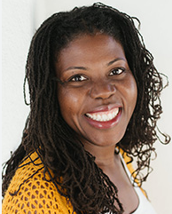
Femi Vance
American Institutes of Research
Notes:
Objective: aligning for

Slide 17
Questions?
Notes:
Org overview – 30 minutes
Defining priorities 1 – 1 hour
Calibrating for Success – 30 Minutes

Slide 19
Common Ground: A Shared Vision
Purpose: Generate a shared understanding of the future state of expanded learning/school day coherence that we are all trying to achieve.
Notes:
Objective: aligning for

Slide 20
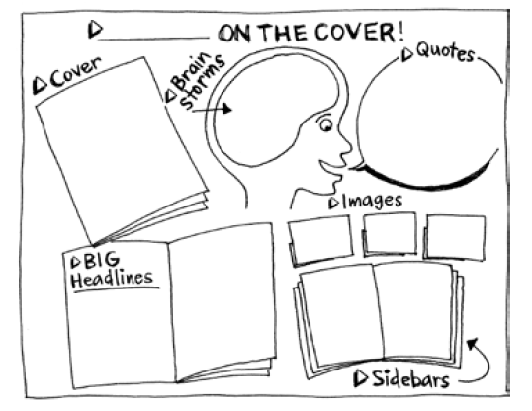
Cover Story
If we are successful, what is the cover story about expanded learning and school day coherence in 10 years?
What are the headline, examples, quotes?
15 min
Don’t forget to choose a presenter
Notes:
T2 - July 2014
Carrie - Sept 2023
Jaclyn - Oct 2023
Zoe - Dec 2022
SPT Dept launch in Fall 2018
expanding Randy's capacity
Government Relations and Advocacy work to support funding consistency
2018 - 3 People, newly resourced 2022
PDT, always existed, in new configuration Fall 2022
Program Design & Student Impact (articulating)
Content and Curriculum for every level of the program
Program Delivery systems and resources
"PDT team prior to 2022 existed of: Sr Dir; 3 Director; 4 PBSs & CCRSs"
The PDT Footprint has
There have been additional resources
Now:
3 Directors
Program Design Trainers
OY Manager
Currently working on Operations
Innovations Lab 2023
Collaborative Design Solutions (Internal and External Collaborators to build new programmatically and new solutions in a collaborative way)
Why do these departments all fall together?

Slide 21
DISCUSSION
What do you notice?
What questions do you have?
What are common themes?
Where are there differences? What questions do they raise? What do they add?
Notes:
Calibrating for Success – 30 Minutes

Slide 22
YOUR TICKET TO LUNCH……
How would this new reality benefit your organization or your students?
Place a sticky note next to your cover story, including your name and organization
Katie/GPG
Our work could focus on impact, not logistics, because schools and districts would be more clear about the resources and staff they have to support students.

Slide 23
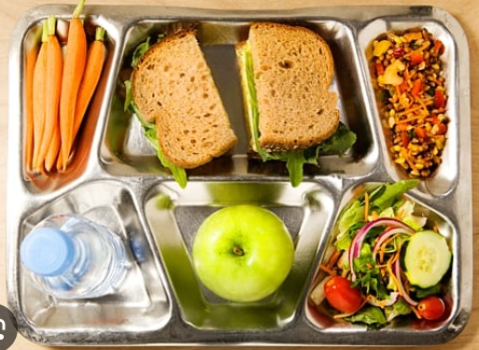

Slide 24
ENERGIZER
Notes:
Calibrating for Success – 30 Minutes

Slide 25
Share your ticket?
How would this new reality benefit your organization or your students?

Slide 26
Common Ground:
The Education Landscape
Purpose: Surface current and anticipated trends in the education landscape that impact if and how expanded learning and school day collaborate.
Notes:
Objective: aligning for

Slide 27
MAPPING THE EDUCATION LANDSCAPE
Find your partner with the same letter on their nametag
Discuss:
What features exist in the current landscape?
What features can we anticipate in the future?
Write:
1 idea/sticky note
5-7 words
Post them on the chart paper:
Make groupings as you see them

Slide 28
FULL GROUP DISCUSSION
What questions do you have?
Now that you see it all, what more would you add?
What are the most important features we should prioritize?

Slide 29
Common Ground:
Barriers to Coherence
Purpose: Understand the barriers to coherence.

Slide 30
POSSIBLE BARRIERS TO COHERENCE
Full Group Discussion:
Is there anything you would add to, or change in, this list?
Different funding streams, each with their own rules and guidelines
Lack of awareness about ELOP funding rules and guidelines
Deeply ingrained siloed ways of working in education
Imbalance of decision-making authority among stakeholders - district leaders, school admin, school boards, unions vs community partners, families, students, ELO staff

Slide 31
Defining Innovative Strategies
Purpose: Based on what we’ve discussed, generate ideas for moving towards our desired state of expanded learning/school day coherence.
Notes:
Objective: aligning for

Slide 32
Key Question
What are the opportunities for coherence between expanded learning and school day practice that we can create or build on to achieve our cover stories?

Slide 33
Steps
1
2
3
Individually,
Brainstorm responses to the key question
Pick your top 2 or 3 ideas
In groups of 4,
Round robin share your ideas
Choose 3 to 5 ideas to share with the whole group
Write them on post-its
– 1 idea/note; 5-7 words
Group them as you present
Key Question:
What are the opportunities for coherence between expanded learning and school day practice that we can create or build on to achieve our cover stories?

Slide 35
GROUP DISCUSSION
What questions do people have?
What areas are you most excited about?
What areas cause concern or raise questions?
What other ideas are coming up for you?
Can we agree on these focus areas?
Notes:
Team Health – 30 Minutes
Org overview – 30 minutes
Defining priorities 1 – 1 hour
Defining Priorities 2 – 1 Hour
OKRs are Homework a
Calibrating for Success – 30 Minutes

Slide 36
FUNDING
What recommendations or advice do people have about funding this work?

Slide 37
Closing & Next Steps
Purpose: Close up the day with clarity about what’s next.

Slide 38
Learn
What is one thing you learned?
What is one idea or action you are eager to pursue?
Share with an elbow partner

Slide 39
NEXT STEPS
Share notes
Convene virtual meetings to action plan
2 or 3 virtual 1.5 to 2 hour meetings in October and November
Final review of the action plan, including structure and co-leadership of the project
Advice on fundraising as interested/able
Notes:
Jennifer
Tommy to close out with final words
Calibrating for Success – 30 Minutes

Slide 40
EXIT TICKET
Notes:
Org overview – 30 minutes
Defining priorities 1 – 1 hour
Calibrating for Success – 30 Minutes

